Slide 1

Long-term Trend on Tumour Thickness of Melanoma in Norway
Faculty of medicine
Raju Rimal
Post-doctoral researcher
Oslo Centre for Biostatistics and Epidemiology
Notes:
Hello! I am Raju. Currently working on the project «Prognosis factor of Melanoma in Norway» funded by research council of Norway.
Before starting the presentation, I would like to talk a little on the background.

Slide 2
Melanoma is the serious form of skin cancer

Slide 3
Notes:
In this study, we like to investigates a long-term trend on tumour thickness, cancer incidence and mortality corresponding to T-categories, both overall and in important subgroups such as sex, age, anatomic sites.
This study incorporates nation wide cases series over 40 year of period.
So, lets talk a little about the tumour, how they are used to staging the cancer.

Slide 4
Notes:
In this study, we like to investigates a long-term trend on tumour thickness, cancer incidence and mortality corresponding to T-categories, both overall and in important subgroups such as sex, age, anatomic sites.
This study incorporates nation wide cases series over 40 year of period.
So, lets talk a little about the tumour, how they are used to staging the cancer.

Slide 5
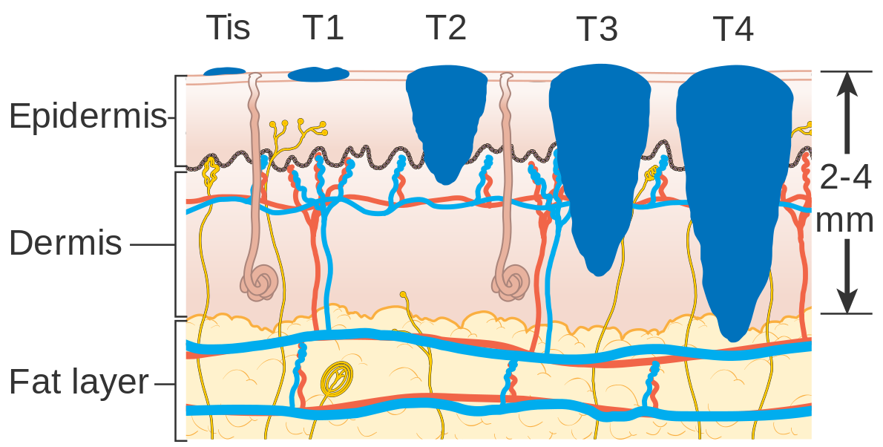
Tumour thickness is the most import prognositic factor
T1
≤1 mm
T2
>1-2 mm
T3
>2-4 mm
T4 >4 mm
In Situ
Source: Cancer Research UK / Wikimedia Commons

Slide 6
To study long-term trends in melanoma tumour thickness, overall and in important subgroups such as sex, age and anatomic sites, in a unique nationwide case series over a 40-year time period.
Aim of the Study
Notes:
In this study, we like to investigates a long-term trend on tumour thickness, cancer incidence and mortality corresponding to T-categories, both overall and in important subgroups such as sex, age, anatomic sites.
This study incorporates nation wide cases series over 40 year of period.
So, lets talk a little about the tumour, how they are used to staging the cancer.

Slide 7
Melanoma in Norway
1953
1980
2000
2008
2019
Melanoma Registration Started
Start of our study
Data on tumour thickness
Ulceration
Less missing
High quality data
Melanoma Registry
End of our study
Less missing and imporved data quality after the melanoma registry established
For this project, data were digitized from the paper archives
Pathologist started to record both present and absent of ulceration
Notes:
Here is a timeline where Norway has started collected data on Melanoma.
We have data on melanoma since 1953 which might be one of the longest time series data on melanoma in the world.
Since 1980, CRN also started to collect data on tumour thickness, however those were on the paper archives which we have recently digitized.
Until 2000, data on ulceration of tumour were not in good quality.
However, in 2008, after Melanoma registry was established we have high quality data on different variables on melanoma.
These are some background, I like to dive into the aim of this study.

Slide 8
Characteristics of Norwegian melanoma cases
Age distribution in three different periods
Tumour thickness is decreasing
Age at diagnosis is increasing
Notes:
Here is some univariate summaries of different variables by Sex in different periods over the years.
We can see the median age at diagnosis has increased from 56 to 63 in women and 59 to 67 in men from the period 1980-1999 to 2008-2019.
Men were diagnosed in later age than women the age at which they were diagnosed has been increased in the recent years.
Age group 40-84 covers more than 70% of the cases. We see that in women aged 60-84 the proportion has raised from 40 to 47 and in men this proportion raised from 46 to 60.
Most cases are in Trunk for men and both trunk and lower limbs is common in women.
The median tumour thickness has decreased over the years in both men and women.
T1 is the most common cases in all period and has increased over the time.
Let us look as some of these proportion by T-stages.

Slide 9
Age adjusted Incidence Rate
Age standardized incidence rate (ASIR) in all categories are increasing over time.
T1 category has the highest ASIR.
Between years 1996 and 2006, a plateau is visible only in T1 category in both sexes.
Notes:
These two plots has same underlying data

Slide 10
Age adjusted Incidence Rate
In thicker cases, the difference in ASIR between men and women have been widening over the years.
Women have higher ASIR than men in T1 category while men have higher ASIR in thicker (T3 and T4) categories
Notes:
These two plots has same underlying data

Slide 11


Age adjusted Incidence Rate
By sex, anatomic site and T category
In men, trunk has highest ASIR.
In women, lower-limbs also has high ASIR in addition to trunk
Only T1 and T2 cases have increasing trend while T3 and T4 have stable and declining trend in the recent years in all sites except head and neck.
Head and neck has lower ASIR compared to other sites but rate in all T categories are increasing.
Notes:
These two plots has same underlying data

Slide 12

Age adjusted Incidence Rate
By sex, histopathological subtype and T category
Superficial Spreading Melanoma (SSM) has highest ASIR than Nodular Melanoma (NM).
T1 cases are common in SSM and has high and increasing trend.
Thicker cases (T3 and T4) are observed mostly in NM. T4 has increasing trend in the recent years.
Plateau observed in T1 is found in SSM cases but the plateau has steady increase after its start.
In NM, a plateau in ASIR is observed in T3 and T4 but in a different period than the overall plateau.
Huge difference in the incidence
In T1 compared to other
Notes:
These two plots has same underlying data

Slide 13
Age-Period-Cohort plot

Slide 14
Preliminary Conclusion
T1-category (thinner tumour) has the highest incidence among all categories and also has increasing trend | Awareness has contributed to the rapid raise in melanoma incidence
Although incidence rate on T1-cases is larger than other, both thicker and thinner cases has a rapid raise in the recent years | Recent raise in melanoma epidemic is not only due to over-diagnosis
T4-category (thicker tumour) also has increasing trend (Average annual percentage change: almost 4% in men and 3% in women) | Thicker tumour has worse prognosis and high mortality. This corresponds with the high mortality rate due to melanoma in Norway.
Men have larger incidence rate in cases with thicker tumour. For the thicker cases, the difference the incidence rate between men and women has been widening over the years | Awareness focused towards elderly male would be effective for early detection. This can help to reduce cases with thicker tumour and consequently to reduce mortality.

Slide 15





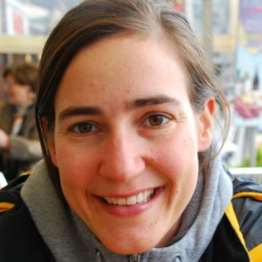






Acknowledgement
The project is funded by
Collaborating Institutes
Raju Rimal
Trude E Robsahm
Adele Green
Reza Ghiasvand
Oslo Centre for Biostatistics and Epidemiology (OCBE)
Corina S Rueegg
Assia Bassarova
Petter Gjersvik
Elisabete Weiderpass
PI
Odd O Aalen
Bjørn Møller
Marit B. Veierød

Slide 16


Slide 17
References
L. X. Clegg, B. F. Hankey, R. Tiwari, et al. "Estimating Average Annual per Cent Change in Trend Analysis". In: Statistics in medicine 28.29 (Dec. 2009), pp. 3670-3682. ISSN: 0277-6715. DOI: 10.1002/sim.3733.
V. M. Muggeo. "Interval Estimation for the Breakpoint in Segmented Regression: A Smoothed Score-Based Approach." In: Australian & New Zealand Journal of Statistics 59 (2017), pp. 311-322. DOI: https://doi-org.ezproxy.uio.no/10.1111/anzs.12200.
V. M. Muggeo. "Segmented: An r Package to Fit Regression Models with Broken-Line Relationships." In: R News 8.1 (2008), pp. 20-25.
S. N. Wood. "Partially Specified Ecological Models". En. In: Ecological Monographs 71.1 (2001), pp. 1-25. ISSN: 1557-7015. DOI: 10.1890/0012-9615(2001)071[0001:PSEM]2.0.CO;2.
Baade, Peter D., David C. Whiteman, Monika Janda, Anne E. Cust, Rachel E. Neale, Bernard Mark Smithers, Adele C. Green, et al. “Long‐term Deaths from Melanoma According to Tumor Thickness at Diagnosis.” International Journal of Cancer, 2020. https://doi.org/10.1002/ijc.32930.
Baade, Peter, Xingqiong Meng, Danny Youlden, Joanne Aitken, and Philippa Youl. “Time Trends and Latitudinal Differences in Melanoma Thickness Distribution in Australia, 1990–2006.” International Journal of Cancer 130, no. 1 (2012): 170–78. https://doi.org/10.1002/ijc.25996.
Cancer Registry of Norway. “Cancer in Norway 2019: Cancer Incidence, Mortality, Survival and Prevalence in Norway.” Cancer Registry of Norway, 2020. https://www.kreftregisteret.no/globalassets/cancer-in-norway/2019/cin_report.pdf.
Erdmann, Friederike, Joannie Lortet-Tieulent, Joachim Schüz, Hajo Zeeb, Rüdiger Greinert, Eckhard W. Breitbart, and Freddie Bray. “International Trends in the Incidence of Malignant Melanoma 1953-2008-Are Recent Generations at Higher or Lower Risk?” International Journal of Cancer 132, no. 2 (2013): 385–400. https://doi.org/10.1002/ijc.27616.

Slide 18
References
Ferlay, J., M. Ervik, F. Lam, and et al. “Global Cancer Observatory: Cancer Today,” 2018.
Garbe, C., U. Keim, T. K. Eigentler, T. Amaral, A. Katalinic, B. Holleczek, P. Martus, and U. Leiter. “Time Trends in Incidence and Mortality of Cutaneous Melanoma in Germany.” Journal of the European Academy of Dermatology and Venereology 33, no. 7 (July 1, 2019): 1272–80. https://doi.org/10.1111/jdv.15322.
Gershenwald, J. E., R. A. Scolyer, K. R. Hess, J. F. Thompson, G. V. Long, M. I. Ross, A. J. Lazar, and M. B. Atkins. “Melanoma of the Skin.” In AJCC Cancer Staging Manual, edited by Amin MB, 8th ed., 563–85. Chicago: Springer, 2017.
Kreftregisteret,. “Årsrapport 2019 Med Resultater Og Forbedringstiltak Fra Nasjonalt Kvalitetsregister for Melanom.” Oslo: Kreftregisteret, 2020.
Kruijff, S., E. Bastiaannet, A. B. Francken, M. Schaapveld, M. van der Aa, and H. J. Hoekstra. “Breslow Thickness in the Netherlands: A Population-Based Study of 40 880 Patients Comparing Young and Elderly Patients.” British Journal of Cancer 107, no. 3 (2012): 570–74. https://doi.org/10.1038/bjc.2012.255.
Robsahm, T. E., P. Helsing, Y. Nilssen, L. Vos, S. M. H. Rizvi, L. A. Akslen, and M. B. Veierod. “High Mortality Due to Cutaneous Melanoma in Norway: A Study of Prognostic Factors in a Nationwide Cancer Registry.” Clin Epidemiol 10 (2018): 537–48. https://doi.org/10.2147/clep.S151246.
Robsahm, Trude E., Gjøril Bergva, Unn E. Hestvik, and Bjørn Møller. “Sex Differences in Rising Trends of Cutaneous Malignant Melanoma in Norway, 1954-2008.” Melanoma Research 23, no. 1 (February 2013): 70–78. https://doi.org/t.
Whiteman, David C., Adele C. Green, and Catherine M. Olsen. “The Growing Burden of Invasive Melanoma: Projections of Incidence Rates and Numbers of New Cases in Six Susceptible Populations through 2031.” The Journal of Investigative Dermatology 136, no. 6 (2016): 1161–71. https://doi.org/10.1016/j.jid.2016.01.035.

